Slide 1

Title: Central Karoo Community Network Project
Main Group Members:
Bornwise Nkateko Baloyi (Group Leader)
Moshokoa Solomon Morongwa
Ramabulana Tshilidzi (Secretary)
Puseletso Mamabolo
Roandiswa Mbedzi

Slide 2

Agenda
Background
Challenges
Solution
Network Infrastructure
Community Involvement
Budget Overview
Timeline
Conclusion

Slide 3

Background
1. Central Karoo is a rural district.
2. Previously counting on a booming railway.
3. Current economy focused on agriculture.
4. Limited fixed telephony and Internet access.
5. 5G rollout is inconsistent and unreliable.

Slide 4
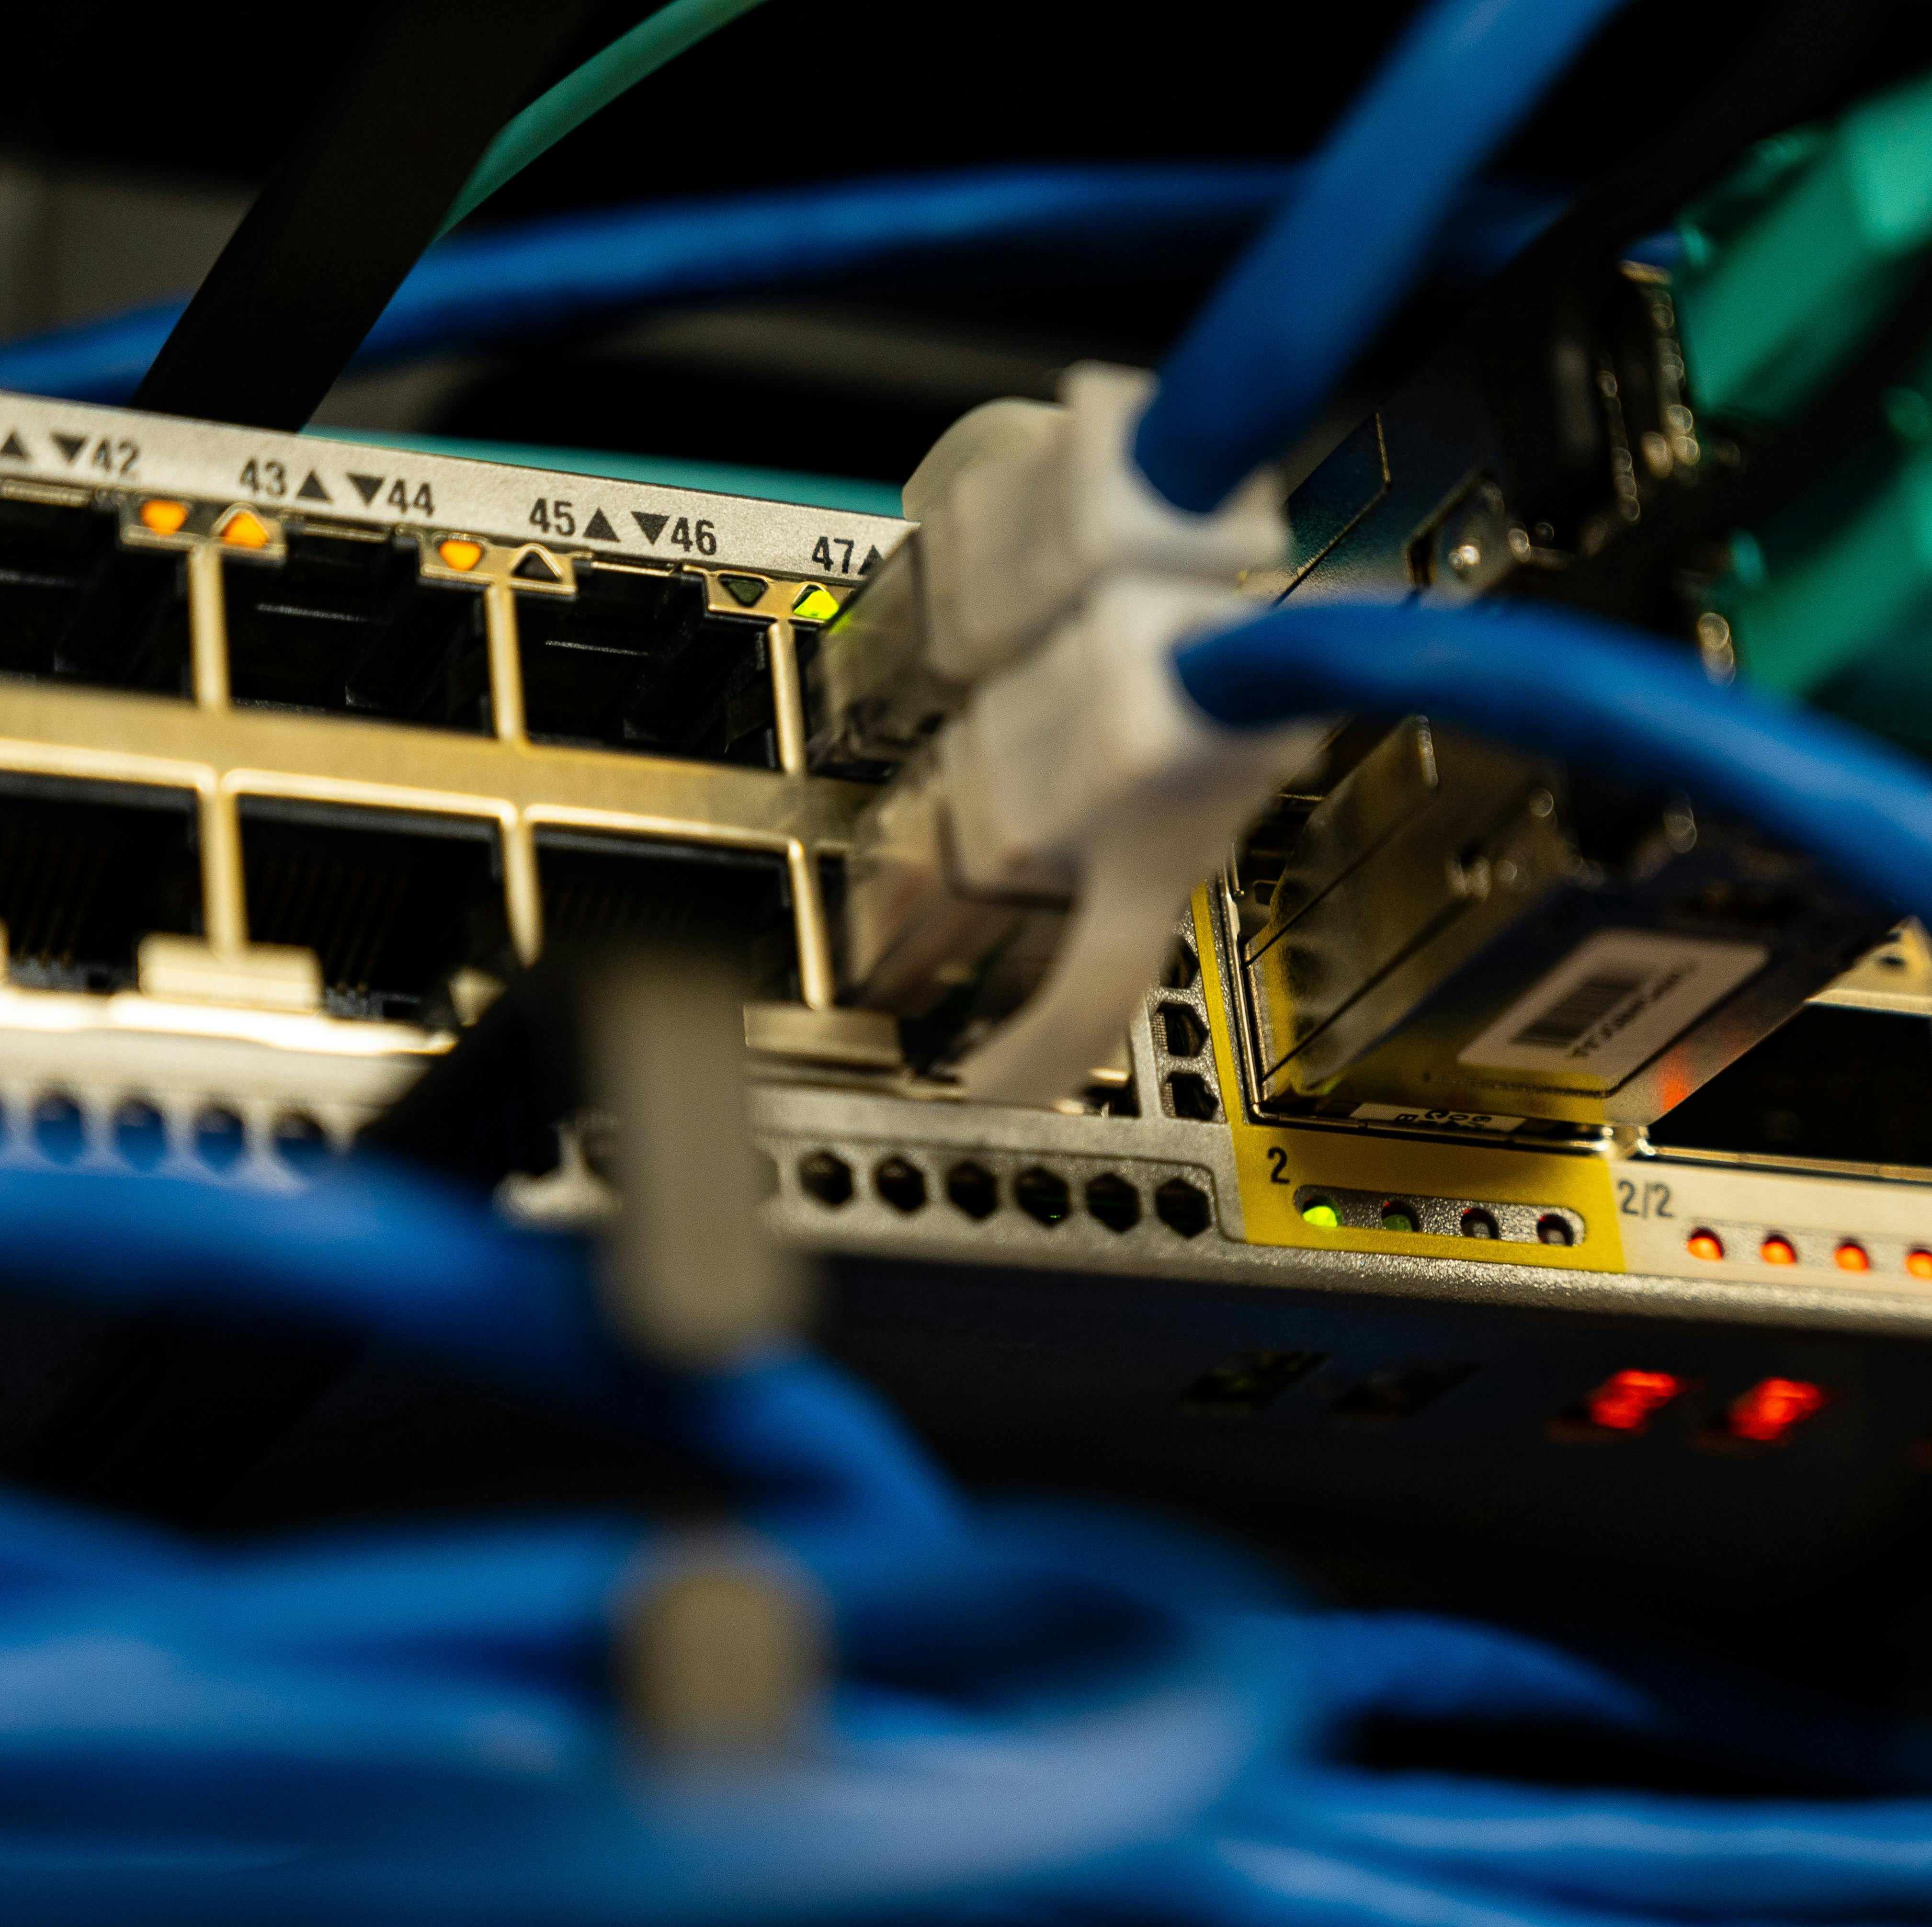
Challenges
Challenges
1. Poor connectivity and network reliability.
2. Security issues with external suppliers.
3. Limited infrastructure in rural areas.
4. Need for intranet and Internet access.
5. Resistance to technology adoption.

Slide 5

Solution
1. Build a robust fiber-optic network.
2. Install local Wi-Fi hotspots for homes.
3. Implement secure access protocols.
4. Provide training for local users.
5. Establish community support and feedback loops.

Slide 6

Network Infrastructure
1. Deploy fiber-optic cabling across the district.
2. Use mesh networks for improved coverage.
3. Set up local servers for data management.
4. Ensure redundancy to minimize downtime.
5. Integrate existing hospital systems securely.

Slide 7

Community Involvement
1. Engage local stakeholders in planning.
2. Recruit community members for training.
3. Foster partnerships with local businesses.
4. Conduct regular community feedback sessions.
5. Promote digital literacy programs.

Slide 8

Budget Overview
Budget Overview
1. Infrastructure Costs: R30 000
Fiber-optic installation: R10 000
Equipment and hardware: R50 000
2. Training Programs: R125 000
Workshops and materials: R55 000
3. Ongoing Maintenance: R25 000
Annual support: R65 000
4. Total Estimated Budget: R360 000

Slide 9

Timeline
1. Month 1-2: Project planning and stakeholder engagement.
2. Month 3-5: Infrastructure installation and testing.
3. Month 6: Community training and onboarding.
4. Month 7-9: Go live and monitor usage.
5. Month 10-12: Evaluate and refine services.

Slide 10

Conclusion
1. Improved connectivity for Central Karoo.
2. Enhanced service delivery for hospitals.
3. Empowered community through technology.
4. Sustainable network for future growth.
5. Collaboration is key to success.

